Slide 1




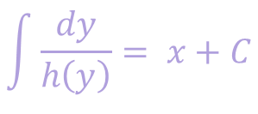






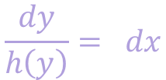
Nth Order Linear ODE
$$a_{n}\left(x\right)\left(\frac{d^{n}y}{dx^{n}}\right)+a_{n−1}\left(x\right)\left(\frac{d^{n−1}y}{dx^{n−1}}\right)+…+a_{1}\left(x\right)\left(\frac{dy}{dx}\right)+a_{0}\left(x\right)y=g(x)$$
1st Order Linear
Separable Variables
$$a_{1}\left(x\right)\frac{dy}{dx}=g(x)$$
$$\frac{dy}{dx}=g(x)$$
$$\frac{dy}{dx}=g\left(x\right)h\left(y\right)$$
$$a_{1}\left(x\right)\frac{dy}{dx}+a_{0}\left(x\right)y=g(x)$$
$$\frac{dy}{dx}+p\left(x\right)y=g(x)$$
1st Order Autonomous
$$\frac{dy}{dx}=h\left(y\right)$$
$$\frac{dy}{h\left(y\right)}= dx$$
$$\int{\frac{dy}{h\left(y\right)}}= x+C$$
$$h(y)≠0$$

Slide 2


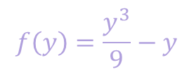

Example
$$\frac{dy}{dx}=\frac{y^{3}}{9}−y$$
$$\frac{dy}{dx}=h\left(y\right)$$
$$h(y)$$
$$f\left(y\right)=\frac{y^{3}}{9}−y$$

Slide 3
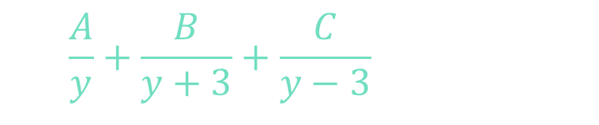



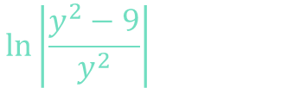
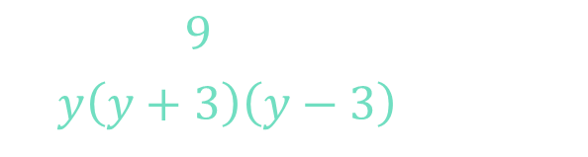










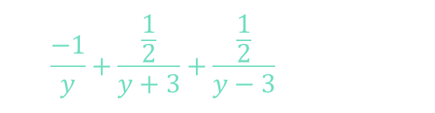
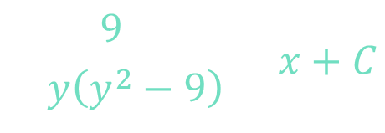



Example
$$\frac{dy}{dx}=\frac{y^{3}}{9}−y$$
$$A\left(y+3\right)\left(y−3\right)+B\left(y\right)\left(y−3\right)+C\left(y\right)\left(y+3\right)=9$$
$$y=0:$$
$$A\left(3\right)\left(−3\right)+B\left(0\right)+C\left(0\right)=9$$
$$A=−1$$
$$\frac{dy}{y^{3}/9−y}= dx$$
$$y=−3:$$
$$A\left(0\right)+B\left(18\right)+C\left(0\right)=9$$
$$B=\frac{1}{2}$$
$$y=3:$$
$$\int{\frac{9dy}{y\left(y^{2}−9\right)}}=x+C$$
$$\int{\left(\frac{−1}{y}+\frac{\frac{1}{2}}{y+3}+\frac{\frac{1}{2}}{y−3}\right)dy}=x+C$$
$$A\left(0\right)+B\left(0\right)+C\left(18\right)=1$$
$$C=\frac{1}{2}$$
$$\ln\left|\frac{y^{2}−9}{y^{2}}\right|=2x+C$$
$$\int{\frac{9dy}{y\left(y+3\right)\left(y−3\right)}}=x+C$$
$$−\ln\left|y\right|+\frac{1}{2}\ln\left|y+3\right| +\frac{1}{2}\ln\left|y−3\right|=x+C$$
$$\left|1−\frac{9}{y^{2}}\right|=Ce^{2x}$$
$$−2\ln\left|y\right|+\ln\left|y+3\right| +\ln\left|y−3\right|=2x+C$$
$$\int{\left(\frac{A}{y}+\frac{B}{y+3}+\frac{C}{y−3}\right)dy}=x+C$$
$$−\ln\left|y^{2}\right|+\ln\left|y^{2}−9\right| =2x+C$$
$$1−\frac{9}{y^{2}}=Ce^{2x}$$

Slide 4

Example
$$\frac{dy}{dx}=\frac{y^{3}}{9}−y$$
$$f\left(y\right)=\frac{y^{3}}{9}−y$$
$$1−\frac{9}{y^{2}}=Ce^{2x}$$

